Slide 1
SA1.0 Proposed CI Environment
DevOps Continuous Delivery
Fabrice Van Leynseele
April, 2015

Slide 2

SA1.0 Proposed Landscape
Jenkins Master
Jenkins Slave
Jenkins Slave
Jenkins Slave
Registry
Images
FUT
DEV
IGT
CSM Cloud
Docker Cluster
GVC Cloud
GitHub Primary
Primary Instance
GitHub Secondary
Secondary Instance
Redundant Backup
Nexus

Slide 3

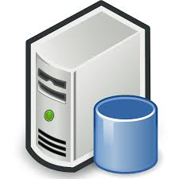
Jenkins CI Architecture Overview
Docker Images
Ansible (Chef)
Automated installation, configuration and administration of Docker hosts and Shipyard
docker pull
CI Docker Cluster
docker push
Shipyard
Docker Cluster
management
and container deployment/deletion, ensuring scalable Jenkins CI Cluster
Jenkins Master
Jenkins Slave
Jenkins Slave
Jenkins Slave
Docker
Registry
Docker Images
Registry
Updated Jenkins images pushed to Registry
Pulled down from VM’s
Run images through Shipyard or command line
Rapid deployment of new Jenkins slaves, ensuring scalability

Slide 4
SA1.0 Proposed CI Environment Summary
Technologies:
Ansible: for Automated installation and configuration
Shipyard: for Docker Container Management
Docker: runs Jenkins Master and Agents images in containers
Jenkins: Build Server and Slaves
Reporting Tools:
Sonar, Fortify, Cobertura, Checkstyle, FindBugs, Fitnesse
Jenkins Plugins:
Git, GitHub, Pull Request builder, Swarm, Sonar, Cobertura, Checkstyle, Findbugs
See current SA2.0 Build Server, mirror of new SA1.0 Environment:
http://sa-jenkins.itcs.hp.com/

